Slide 1
Introduction to Meta-analysis
Terri Pigott
Knowledge Center for Education
University of Stavanger
May 13, 2022

Slide 2
Goals for the Presentation
Discuss the relationship between systematic review and meta-analysis
Provide examples of questions addressed by meta-analysis
Present examples of meta-analysis results
Consider interpretations of meta-analysis results

Slide 3
Definition of systematic review
A systematic review
Uses explicit criteria and transparent, replicable processes
To identify, assess and synthesize results of multiple studies
To address a central research question
While minimizing bias and error at each step

Slide 4
This definition of systematic review
Assumes that the goal of the review is to be transparent
Assumes that the review is focused on synthesizing a set of studies identified through a replicable process
There could be multiple ways that these studies are synthesized depending on the research question and relevant literature

Slide 5
SYSTEMATIC REVIEW OR RESEARCH SYNTHESIS
Meta-Analysis
Evidence and Gap Maps
Conceptual Reviews
Overviews
Qualitative Synthesis
Scoping Reviews

Slide 6
Today we will talk about meta-analysis
Meta-analysis is a set of statistical methods used to synthesize the quantitative results across a set of studies
We will focus on the synthesis of quantitative studies in this talk
I will also assume that a meta-analysis is being conducted using systematic review methods

Slide 7
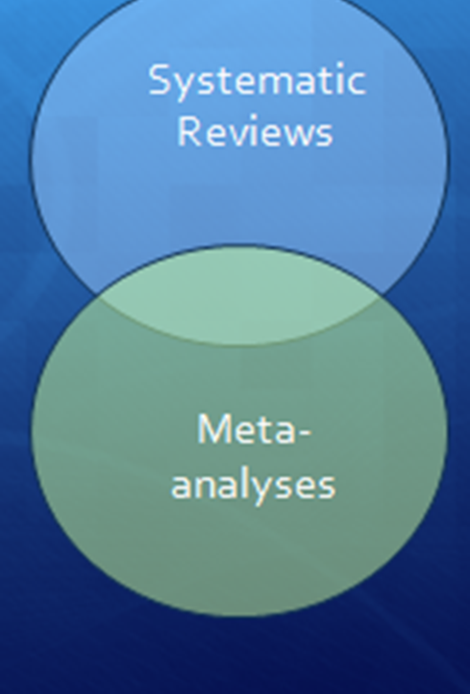
Remember
Systematic Reviews don't always include meta-analyses
And some meta-analyses might not use systematic review techniques
Today I assume that we are conducting a meta-analysis as part of a systematic review

Slide 8
1. Problem formulation
2. Searching the literature
3. Screening potentially eligible studies
4. Data extraction and coding
Feedback can lead to repeating any or all steps
Cross-step synergy
5. Data analysis and synthesis (meta-analysis)
6. Interpretation and dissemination
7. Re-analysis, development, or criticism
Adapted from Johnson & Hennessy (2019)

Slide 9
Meta-Analysis steps
After conducting a systematic search of the literature and screening for eligible studies, we extract measures of each studies’ effect
This effect size is then used as the unit of analysis in the meta-analysis part of the systematic review

Slide 10
Types of questions addressed by meta-analysis

Slide 11
Types of questions relevant for meta-analysis
Rates and Trends
Associations
Cause and Effect
Any question where the goal is to estimate a quantitative measure across studies

Slide 12
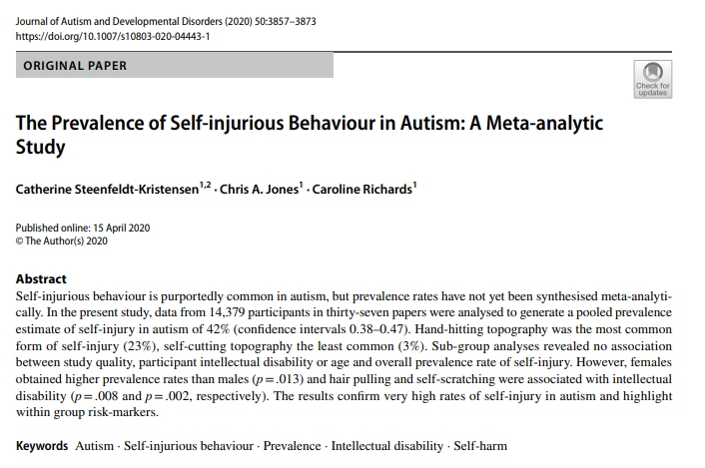
Rates/Trends
What is the prevalence of this behavior among persons with autism?

Slide 13
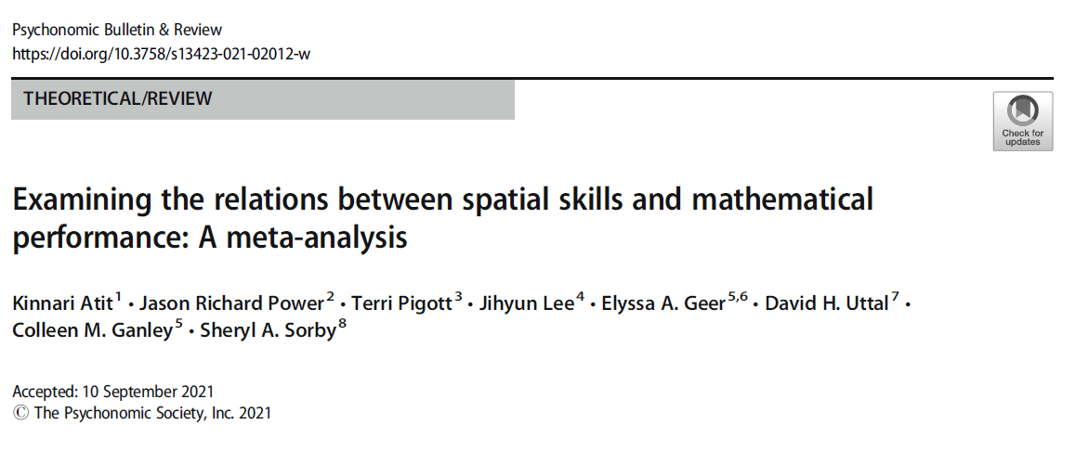
Associations - Correlations
What is the correlation between spatial skills and mathematics performance?
Does this correlation vary across studies?

Slide 14
Associations – comparisons among groups
What is the difference in academic achievement among first- and second-generation youths?
How does that difference (if it exists) vary across studies?

Slide 15
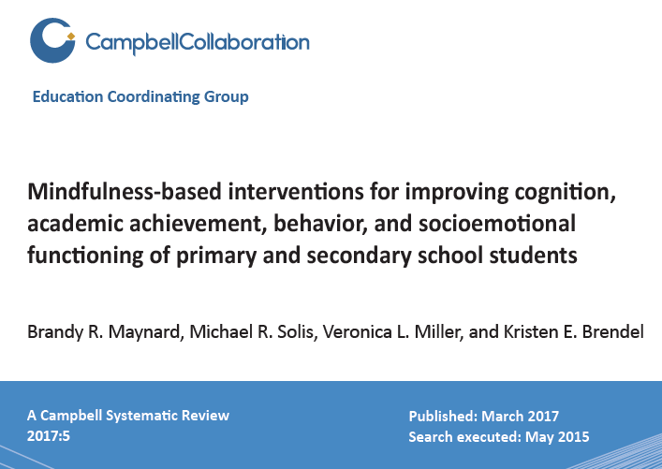
Effectiveness of interventions

Slide 16
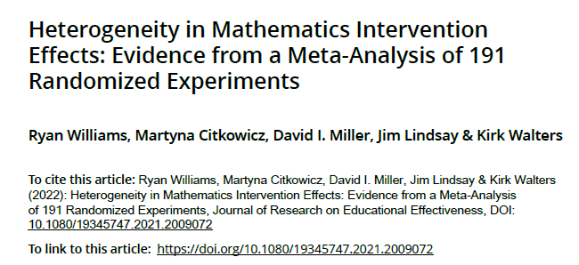
Effectiveness of interventions

Slide 17
What are typical results from a meta-analysis?

Slide 18
In a meta-analysis, we are concerned with:
Estimating the average effect size (treatment effectiveness, correlation between constructs, prevalence of a condition) and its confidence interval
Estimating the variation among studies in effect size – or exploring the heterogeneity among studies

Slide 19
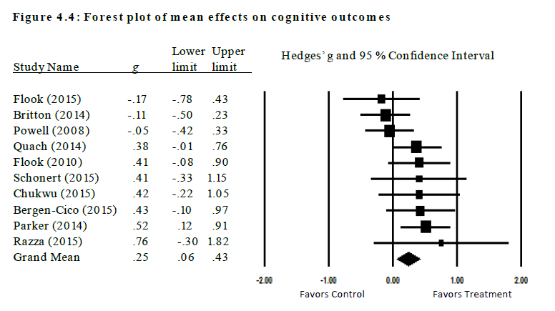
Forest plot from mindfulness review
Mean effect size and 95% CI:
0.25, [0.06, 0.43]

Slide 20
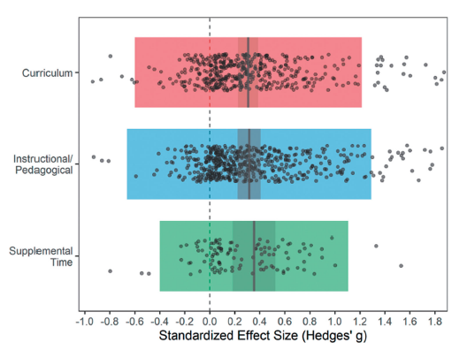
Mathematics Interventions - Heterogeneity

Slide 21
Exploring heterogeneity
Tool based on the Mathematics interventions here:
https://www.air.org/centers/mosaic/mosaic-tools
You can explore the effect sizes from different interventions, using different measures in varying contexts

Slide 22
What conclusions can we draw from a meta-analysis?

Slide 23
Meta-analysis questions
As we have seen in our examples, meta-analysis results can
Provide an estimate of the average effect across studies – such as the average treatment effect, or the average correlation between constructs
Describe how the amount of variation across studies
Explore the relationship among study characteristics and effect size

Slide 24
Exploring heterogeneity and generalizing results
When we explore how study characteristics relate to effect size, we are really addressing a question about generalizability
With treatment effectiveness, we are exploring how much treatments vary, for whom they are most effective, and in what contexts they are effective
For other types of questions: how variable are the effects across studies?

Slide 25
Summary
Meta-analysis is used in the context of a systematic review to synthesize results of quantitative studies
Meta-analysis results can describe the average effect across studies, and examine the amount of variation in effects
Meta-analysis can summarize what we know and what we don’t yet know about a given research area

Slide 26
Thank you!
Terri Pigott
tpigott@gsu.edu

Slide 27
General resources for systematic review
Cooper, H. (2017). Research synthesis and meta-analysis: A step-by-step approach (Fifth). Sage Publications.
Gough, D., Oliver, S., & Thomas, J. (2017). An introduction to systematic reviews (2nd ed.). Sage Publications.

Slide 28
Resources for Meta-analysis
Cochrane Handbook for Systematic Reviews of Interventions (health-focused):
https://training.cochrane.org/handbook
Meta-analysis Learning Information Center (social science focused with R resources and videos): https://www.meta-analysis-learning-information-center.com/
Wolfgang Viechtbauer’s metafor R package: https://www.metafor-project.org/doku.php/metafor

Slide 29
Books/Papers on meta-analysis
Borenstein, M., Hedges, L. V., Higgins, J. P. T., & Rothstein, H. R. (2009). Introduction to Meta-Analysis (2nd ed.). Wiley.
Cooper, H., Hedges, L. V., & Valentine, J. C. (2019). The Handbook of Research Synthesis and Meta-Analysis (3rd ed.). Russell Sage Foundation.
Lipsey, M. W., & Wilson, D. B. (2001). Practical meta-analysis. Sage Publications.
Pigott, T. D., & Polanin, J. R. (2020). Methodological Guidance Paper: High-Quality Meta-Analysis in a Systematic Review. Review of Educational Research, 90(1), 24–46. https://doi.org/10.3102/0034654319877153

Slide 30
Publication Bias Papers/Resources
Egger, M., Smith, G. D., Schneider, M., & Minder, C. (1997). Bias in meta-analysis detected by a simple, graphical test. BMJ, 315(7109), 629–634. https://doi.org/10.1136/bmj.315.7109.629
Hedges, L. V., & Vevea, J. L. (1996). Estimating Effect Size Under Publication Bias: Small Sample Properties and Robustness of a Random Effects Selection Model. Journal of Educational and Behavioral Statistics, 21(4), 299–332. https://doi.org/10.3102/10769986021004299
Marks-Anglin, A., & Chen, Y. (2020). A historical review of publication bias. Research Synthesis Methods, 11(6), 725–742. https://doi.org/10.1002/jrsm.1452
Mathur, M. B., & VanderWeele, T. J. (2021). Estimating publication bias in meta-analyses of peer-reviewed studies: A meta-meta-analysis across disciplines and journal tiers. Research Synthesis Methods, 12(2), 176–191. https://doi.org/10.1002/jrsm.1464
Rodgers, M. A., & Pustejovsky, J. E. (2020). Evaluating meta-analytic methods to detect selective reporting in the presence of dependent effect sizes.. Psychological Methods, 26(2), 141-160.

